Slide 1
ADC
Lecture 8

Slide 2
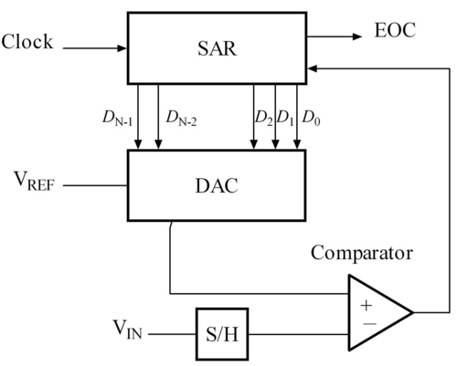
SAR
The successive approximation ADC typically consists of four chief subcircuits:
A sample and hold circuit to acquire the input voltage (V_{in}).
An analog voltage comparator that compares V_{in} to the output of the internal DAC and outputs the result of the comparison to the successive approximation register (SAR).
A successive approximation register subcircuit designed to supply an approximate digital code of V_{in} to the internal DAC.
An internal reference DAC that supplies the comparator with an analog voltage equivalent of the digital code output of the SAR for comparison with V_{in}.

Slide 3
Features
10 bit successive approximation ADC
8 single ended and 7 differential inputs
Reference voltage provided by
  AVcc pin = Vcc or 5v
  AREF = external voltage reference pin
  2.56 V (internal reference)
Runs in Single Conversion Mode or Free Running Mode

Slide 4
Starting Conversion
Single Conversion Mode:
  Setting the ADSC bit in the ADSCR-A register (ADC Status and Control Register – A) starts the first conversion. Once the conversion is complete the bit is automatically cleared and needs to be set again to start the next conversion
Alternatively, a conversion can be triggered automatically by various sources. Auto Triggering is enabled by setting the ADC Auto Trigger Enable bit, ADATE in ADCSRA. The trigger source is selected by setting the ADC Trigger Select bits, ADTS in SFIOR (see description of the ADTS bits for a list of the trigger sources). When a positive edge occurs on the selected trigger signal, the ADC prescaler is reset and a conversion is started

Slide 5
Conversion Modes
Free Running Mode:
  Started by setting ADFR bit to 1. The next conversion starts once the previous conversion ends. The ADC data register gets updated at every conversion. The first conversion starts by setting ADSC bit.

Slide 6
Changing Input Channels
In single conversion mode it is best to select the channel before conversion starts and change it after conversion ends
In free running mode it is best to select the channel before the first conversion starts and if required to be change to change it after the conversion ends. Since the next conversion has already started by this time the new channel selection will only be reflected from subsequent new conversions

Slide 7
ADC Conversion Results
Conversion results stored in ADC registers ADCH, ADCL. The input voltage is calculated as (ADC/1024)*Vref

Slide 8
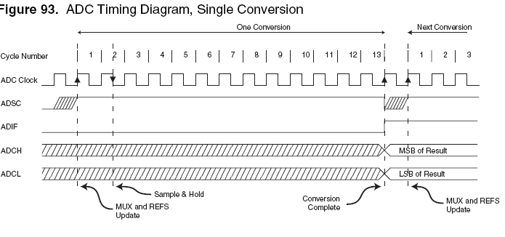

Single Conversion Timing Diagram

Slide 9

Register Details
ADEN: Writing 1 to this enables the ADC, 0 disables
ADSC: Start conversion bit (discussed before)
ADATE: When this bit is written to one, Auto Triggering of the ADC is enabled. The ADC will start a conversion on a positive edge of the selected trigger signal. The trigger source is selected by setting
the ADC Trigger Select bits, ADTS in SFIOR.
ADIF: ADC interrupt flag. Gets set when ADC conversion is complete and data registers are updated. Cleared by hardware when the corresponding interrupt is serviced or by writing a 1 to this flag
ADIE: Activates the ADC conversion complete interrupt

Slide 10

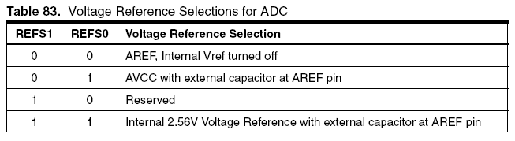
Register Details
MUX2 to MUX0 = Selects the channel (single ended)

Slide 11

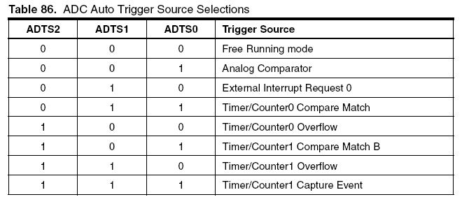
Register Details

